Slide 1

Introduction to Spark

Slide 2
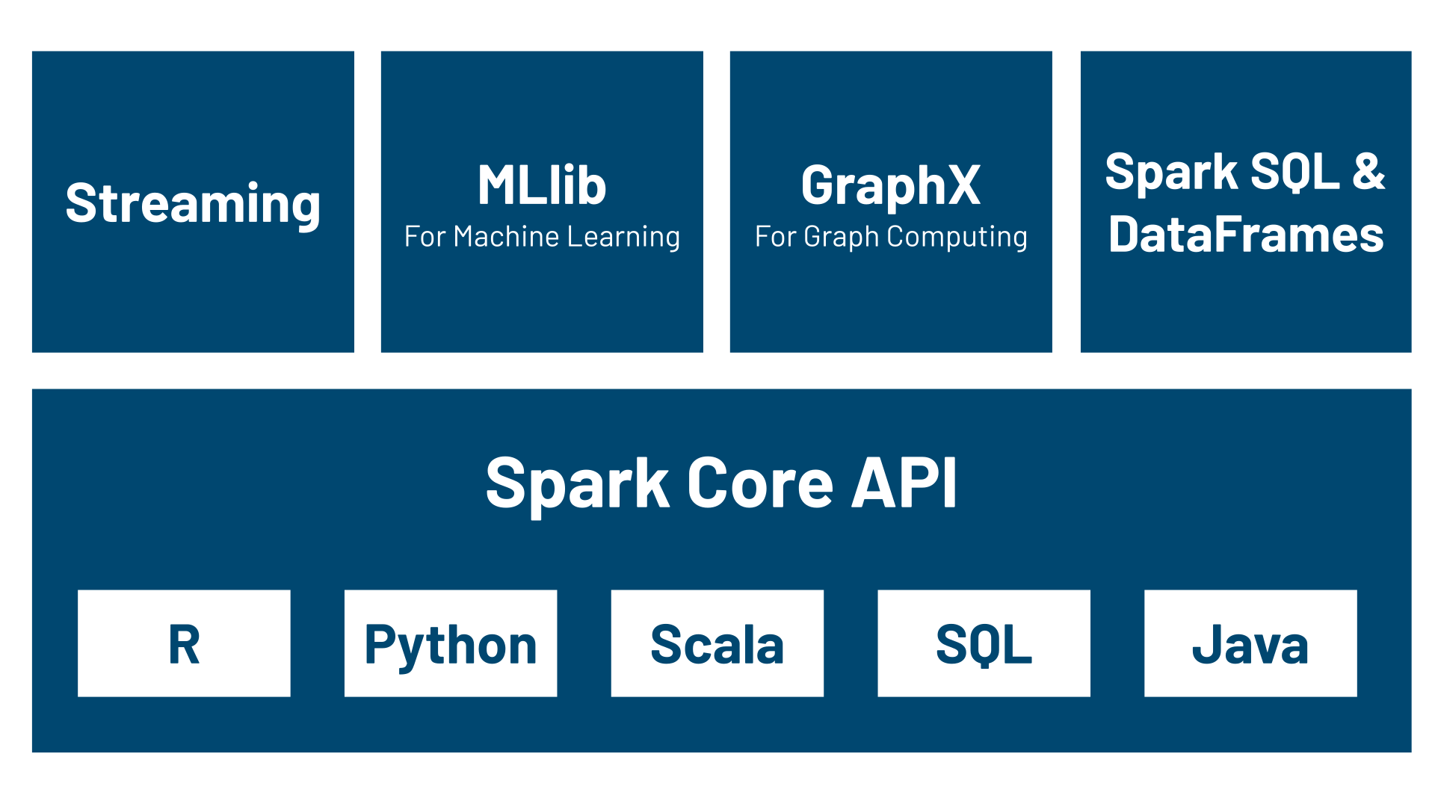
Spark Ecosystem

Slide 3
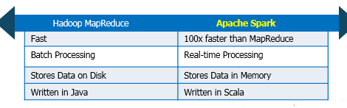
Hadoop Vs Spark

Slide 4
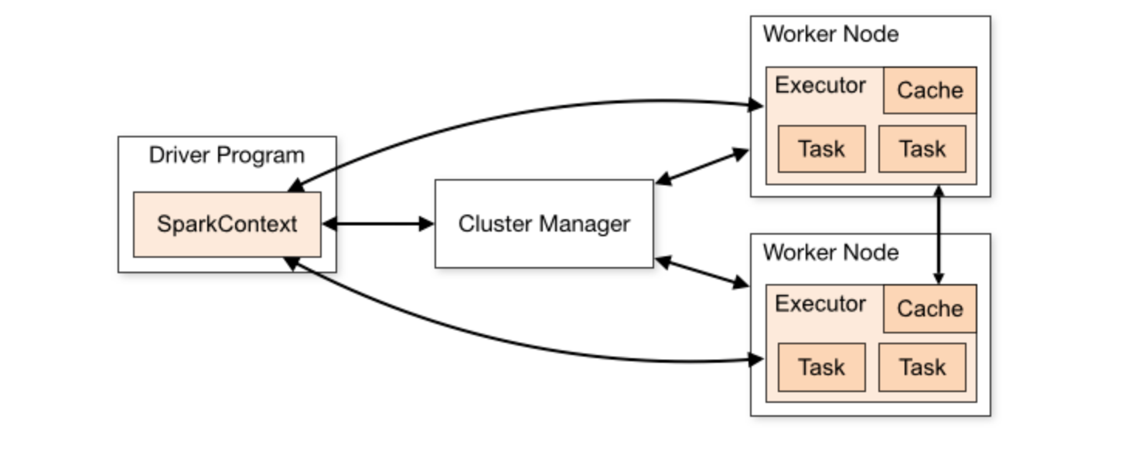
Architecture of Spark

